Slide 1

JERUSALEM COLLEGE OF ENGINEERING
PALLIKARANAI,CHENNAI-600100
DEPARTMENT OF INFORMATION TECHNOLOGY
SMART FARMER –IOT ENABLED SMART FARMING APPLICATION
PRESENTED BY: KISHORE V(130719205025), SUPERVISOR : Dr. MAYA EAPEN,
BAVANI V(130719205011), Professor
JEEVANANDHAM V(130719205022),
MANIBHARATHY P(130719205028)

Slide 2
OBJECTIVES
To help farmers automate their farms by providing them with a web app
To adapt and build resilience to climate change
To increase agriculture productivity and incomes
To get the live data from the farming field

Slide 3
PROBLEM STATEMENT
Farmer are to be present at form for it’s maintenance irrespective of the weather conditions. They have to ensure that the crops are well irrigated and the farm status is monitored by them physically.
Farmer have to stay most of the time in field in order to get a good yield. In difficult times like in the presence of pandemic also they have to work hard in their fields risking their lives to provide food for the country.

Slide 4
ABSTRACT
This system can monitor soil moisture and climatic conditions to grow and yield a good crop. This can also get the real time weather forecasting data by using external platforms like Open Weather API.
Farmer will be provided a mobile app or a web app which is used to monitor the farming field parameters . Based on all parameter , farmer can water his crop by controlling the motor using the application.
Even in the absence of farmer near the field , Farmer can able to monitor the field using the application from anywhere.

Slide 5
INTRODUCTION
The main aim of the project is to help farmers by providing them with a web or mobile application.
By using the application farmer can monitor all the parameters of the field such as temperature, humidity, soil moisture, etc…
And even they can be able to control the equipments the fields like water motors and other devices remotely via internet.

Slide 6
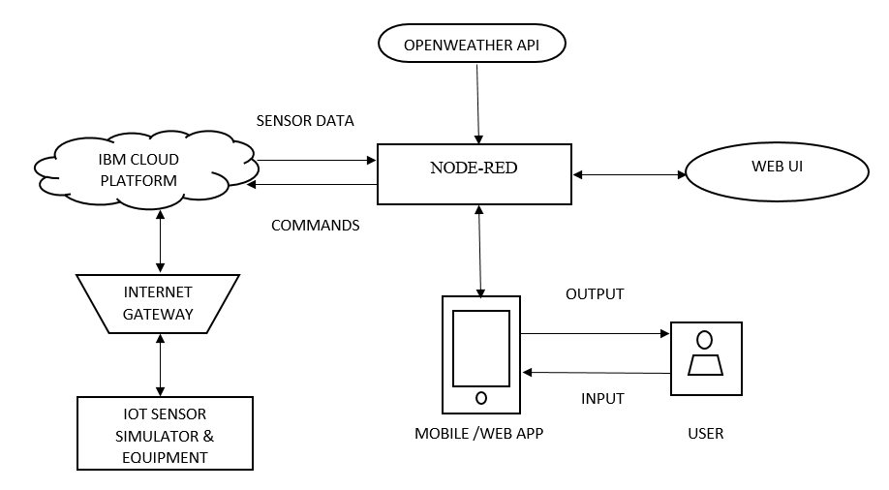
ARCHITECTURE DIAGRAM

Slide 7
MODULES
IOT SENSOR SIMULATOR
IBM WATSON PLATFORM
NODE-RED
OPENWEATHER API

Slide 8
MODULES DESCRIPTION
IOT SENSOR SIMULATOR
Instead of sensor, we are using IOT sensor simulator which give random readings to the connected cloud.
INPUT : Randomly generated value or Manual input
OUTPUT : Sending the generated value to the cloud through internet
IBM WATSON IOT PLATFORM
It is a managed, cloud-hosted services to make it simple to derive a value from the IOT devices.
INPUT : Data from simulator(Sensor data)
OUTPUT : Commands from the User(Farmer)

Slide 9
MODULES DESCRIPTION
NODE-RED
It provides a web browser-based flow editor which can be used to create a JavaScript functions.
INPUT : Attribute FlowChart
OUTPUT : JavaScript functions(Web UI)
OPENWEATHER API
It is a online service that provides a weather data.
INPUT : Global Weather Data

Slide 10
THANK YOU!!!!!!!

